Slide 1




EXCHANGE ONLINE
MAIL FLOW
EXCHANGE ONLINE MAIL FLOW WITH POWERSHELL COMMANDS
PREPARED BY:
MAHAM WASEEM

Slide 2
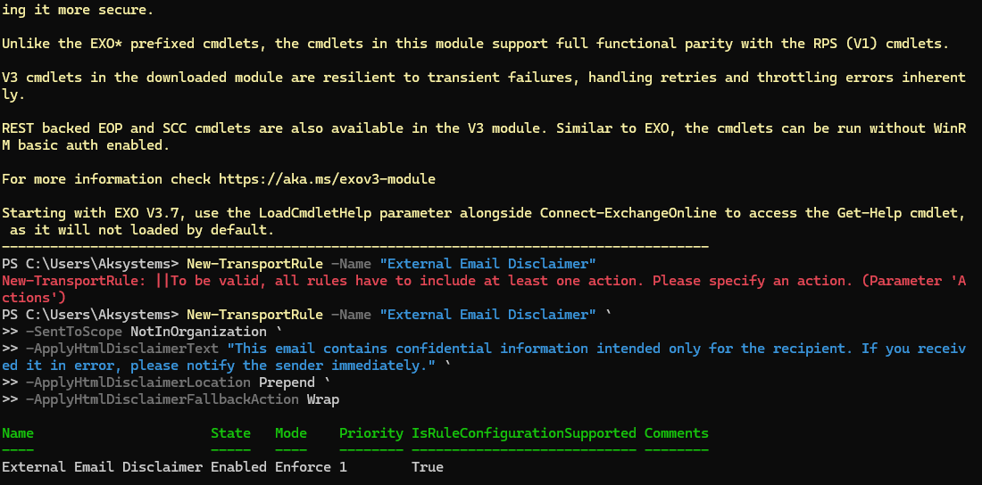
AUTOMATIC DISCLAIMER ADDED TO THE EXTERNAL EMAILS
POWER SHELL COMMAND

Slide 3
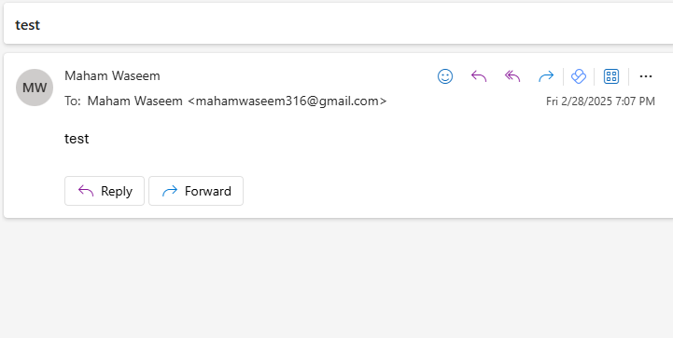
AUTOMATIC DISCLAIMER ADDED TO THE EXTERNAL EMAILS
Test Email Sent

Slide 4
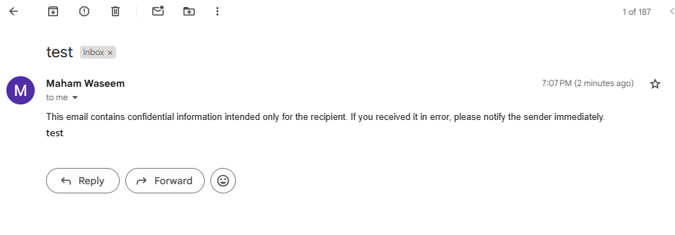
AUTOMATIC DISCLAIMER ADDED TO THE EXTERNAL EMAILS
Results on the other email

Slide 5
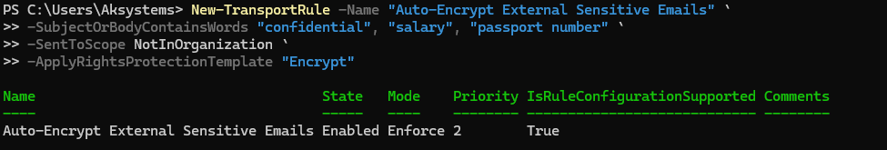
Auto-Encrypting Emails Containing Sensitive Information
POWER SHELL COMMAND

Slide 6
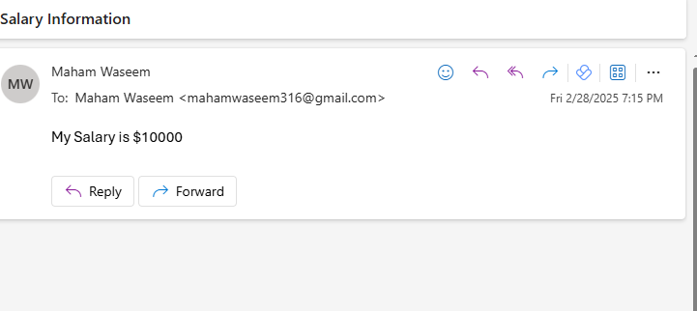
Auto-Encrypting Emails Containing Sensitive Information
Test Email Sent

Slide 7
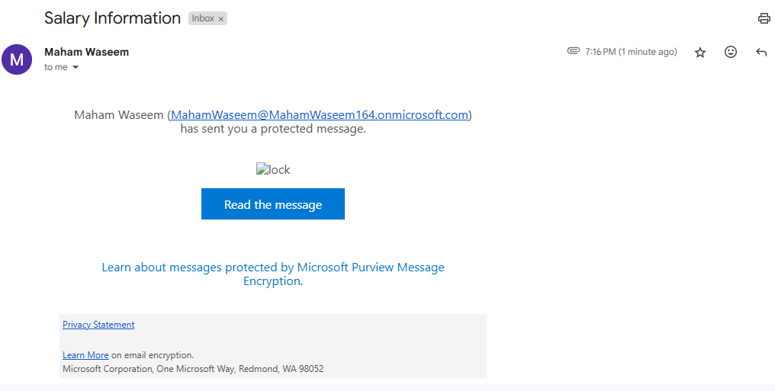
Auto-Encrypting Emails Containing Sensitive Information
Results

Slide 8
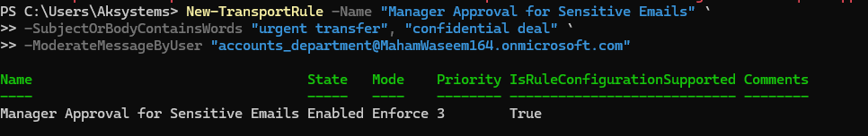
DELAY EMAILS FOR MANAGER APPROVAL
POWER SHELL COMMAND

Slide 9
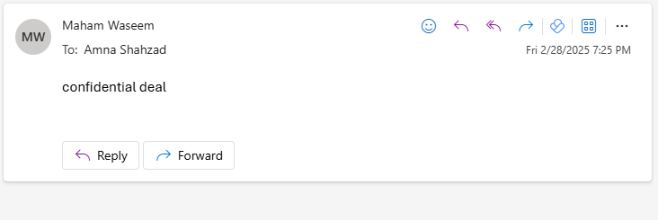
DELAY EMAILS FOR MANAGER APPROVAL
Test Email Sent

Slide 10
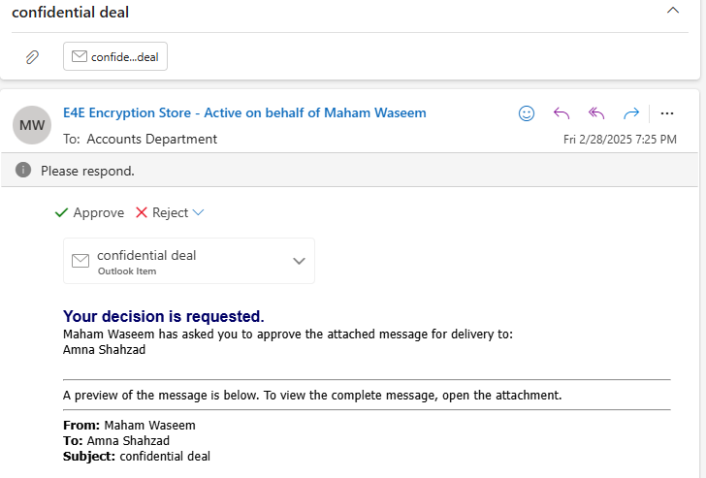
DELAY EMAILS FOR MANAGER APPROVAL
Results

Slide 11
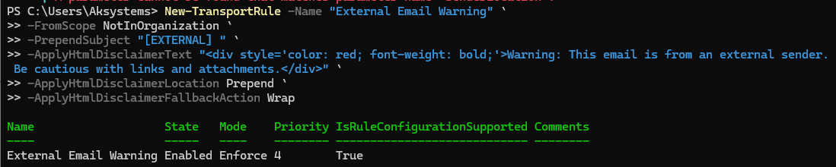
ADD A WARNING BANNER FOR EXTERNAL EMAILS
POWER SHELL COMMAND

Slide 12
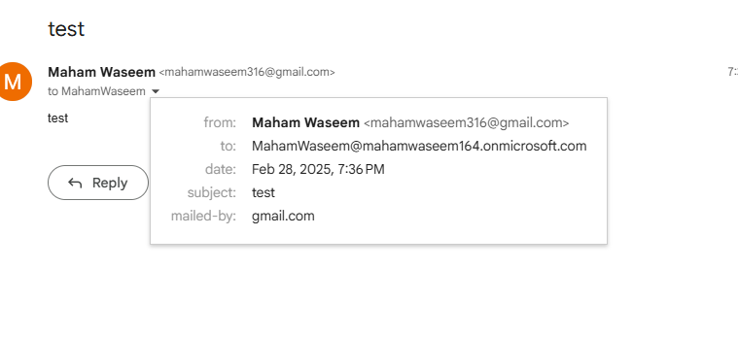
ADD A WARNING BANNER FOR EXTERNAL EMAILS
Test Email Sent

Slide 13
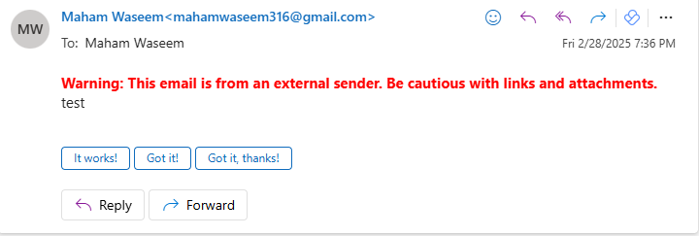
ADD A WARNING BANNER FOR EXTERNAL EMAILS
Results

Slide 14
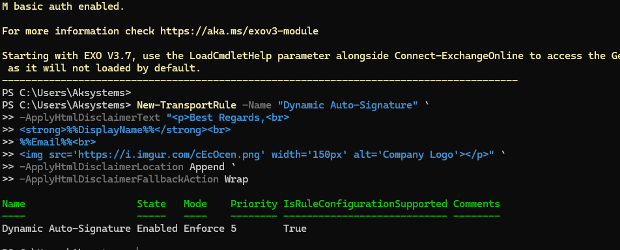
DYNAMIC EMAIL SIGNATURE
POWER SHELL COMMAND

Slide 15
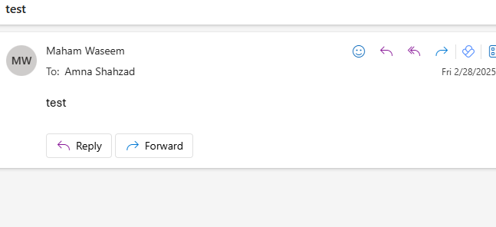
DYNAMIC EMAIL SIGNATURE
Test Email Sent

Slide 16
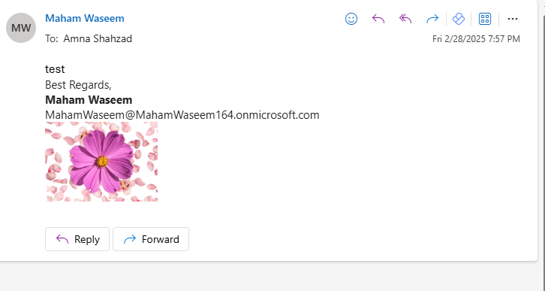
DYNAMIC EMAIL SIGNATURE
Results

Slide 17
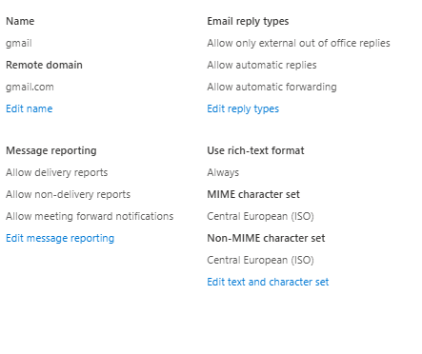
REMOTE DOMAIN PROBLEM: AUTOMATIC EMAIL RECEIVED TO THE EXTERNAL ACCOUNT
Exchange Online Flow Setup

Slide 18
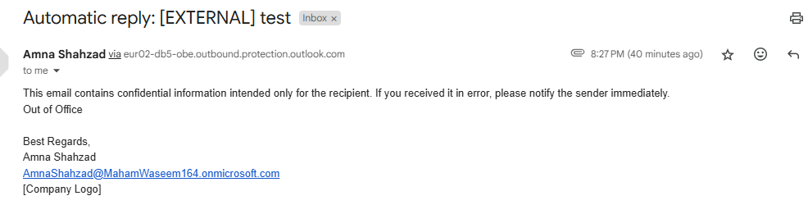
REMOTE DOMAIN PROBLEM
Automatic Emails Received to the External Accounts

Slide 19
REMOTE DOMAIN PROBLEM
External Forwarding Blocked for Specific Remote Domains
POWER SHELL COMMAND
Results: Automatic Emails to the External Accounts Not Received

Slide 20
Thank You!

